Slide 1

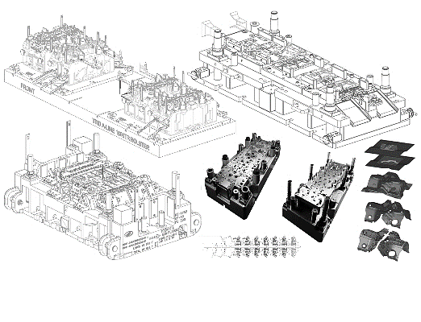
TAPOVAN TOOLS & PROTO TECH LLP
EXCELLENCE IN ENGINEERING SOLUTIONS

Slide 2
About Us
TAPOVAN started its journey in 2007 operating from Pune as a commercial tool room. We are focussing on tool manufacturing. Be it in automotive tooling, non automotive tooling, progressive tools, proto tools or precision machining, we have it all under one roof.
Total Employees :- 75.
Shop Floor area :- 13000 Sqft.
BUSINESS STATEMENT
Our core business strategy is to provide innovative engineering solutions. Maintaining strategic partnership with customers and being One stop Solution for our clients. We are committed to continuous Improvements in Productivity and Operational efficiency in a challenging business environment.
OUR COMPETITIVE ADVANTAGE
In-house product design, tool design & tool manufacturing.
High end design software's.
In-house production & try-out facility.
Engineering services.
OUR CAPACITY
Automotive tools :- 400 no's / year (Avg. size 2.0 mtr).
Progressive tools :- 50 no`s / year (Avg. size 2.0 mtr).

Slide 3
Our Services
Tooling
Production
1. Progressive Tools
1. Sheet Metal Stamping
2. Tandem Tools
2. Engineering Services
3. Proto Tools
3. Proto Parts
4. Assembly/Welding/Checking Fixtures

Slide 4
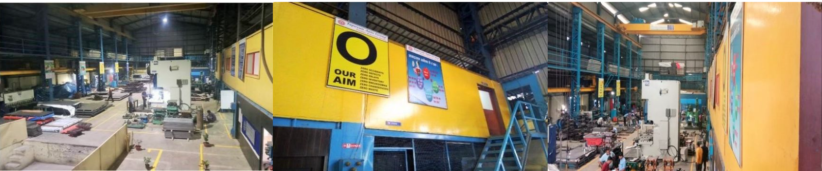
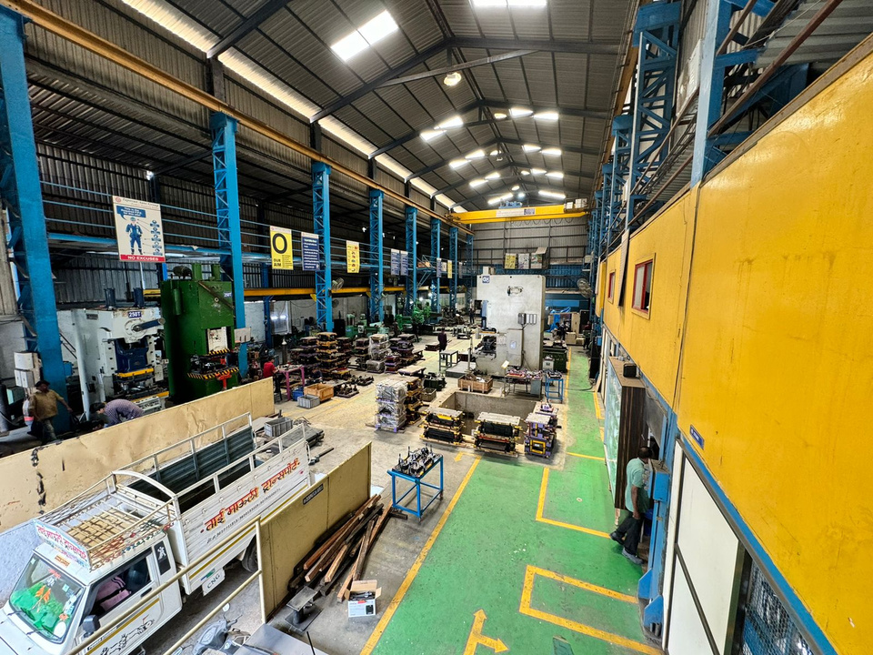
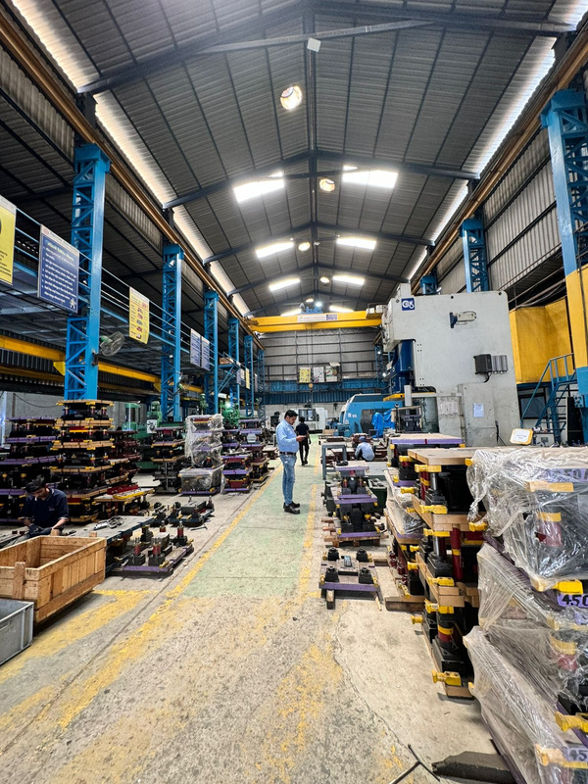
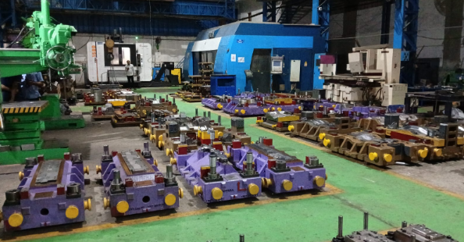
Shop floor

Slide 5
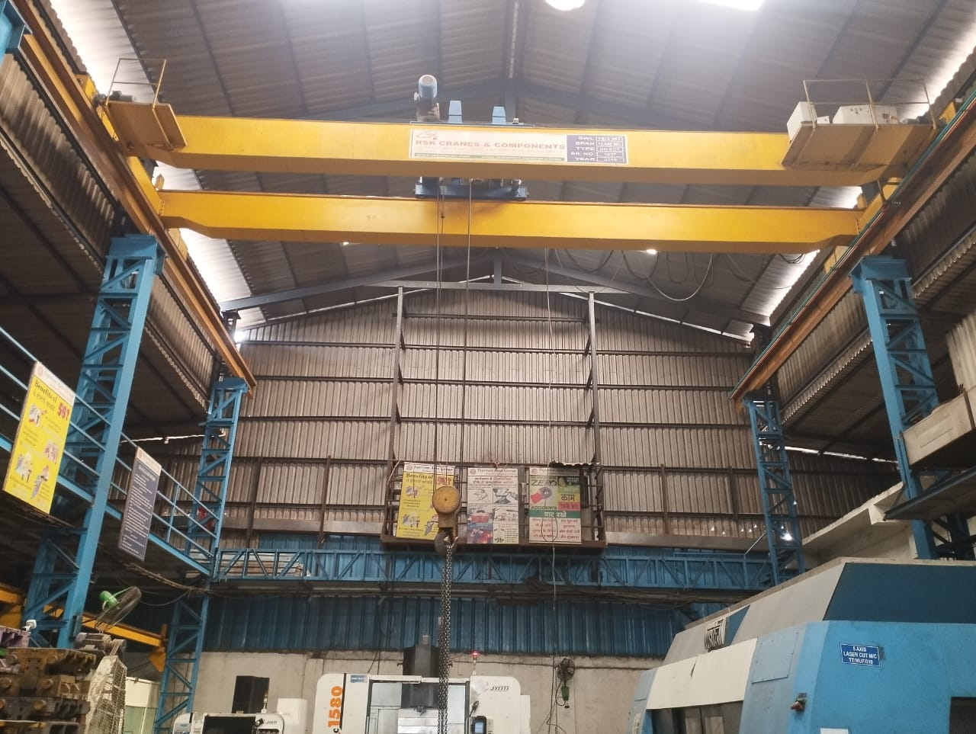
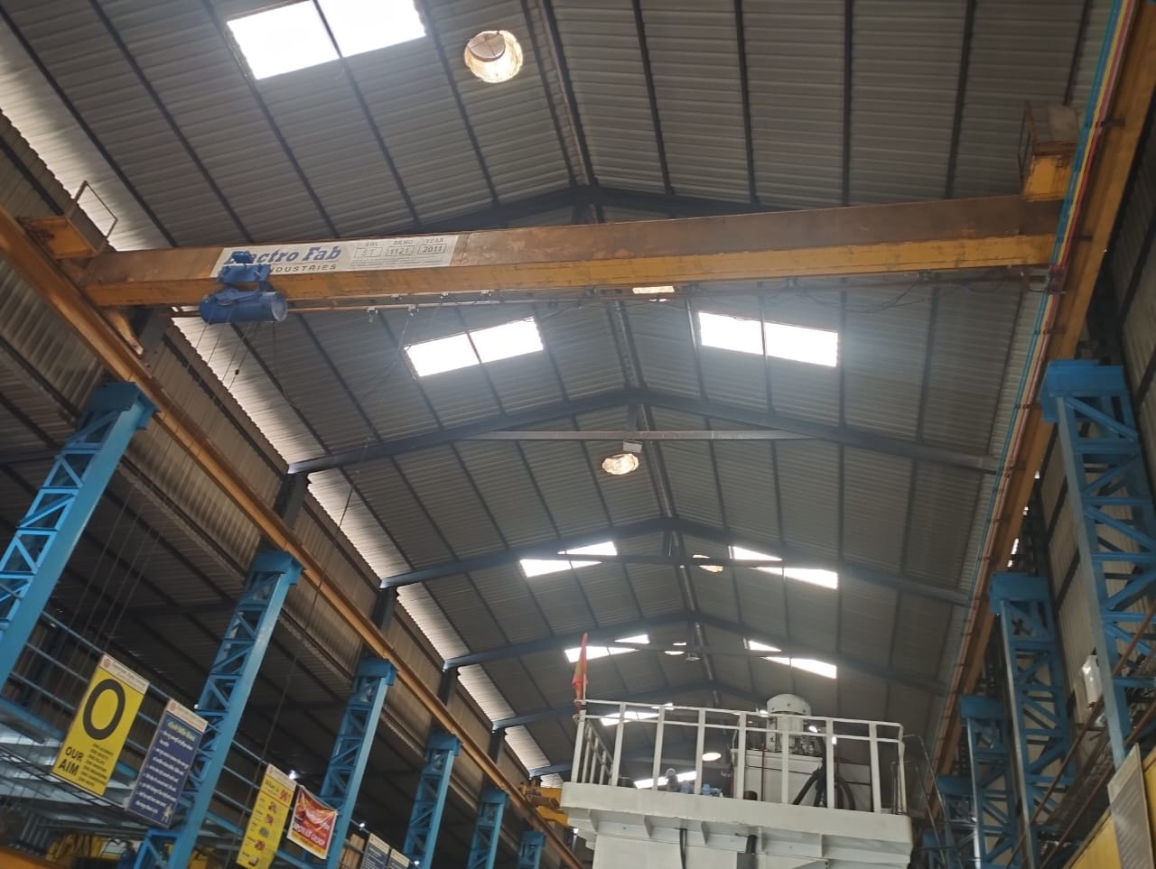
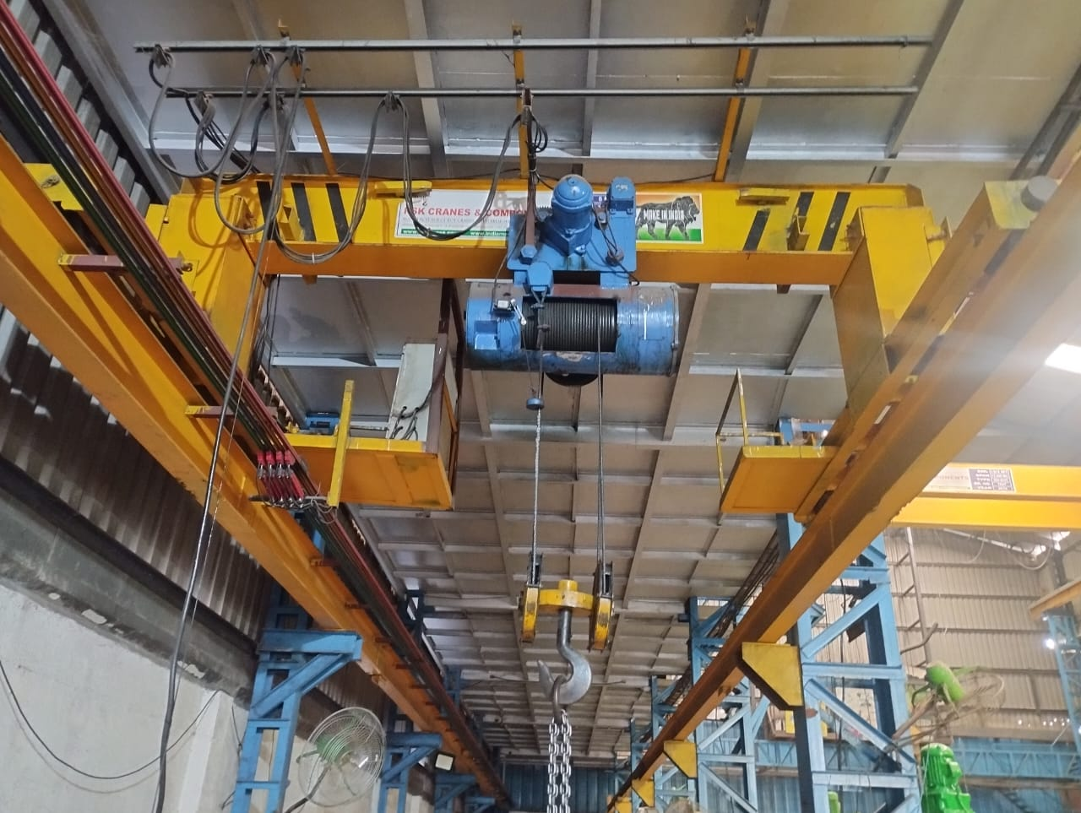
Over head crane
Press shop Over head crane 15 Ton
Press shop Over head crane 5 Ton
Tool room Over head crane 5 Ton

Slide 6
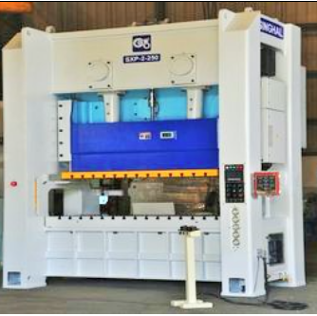
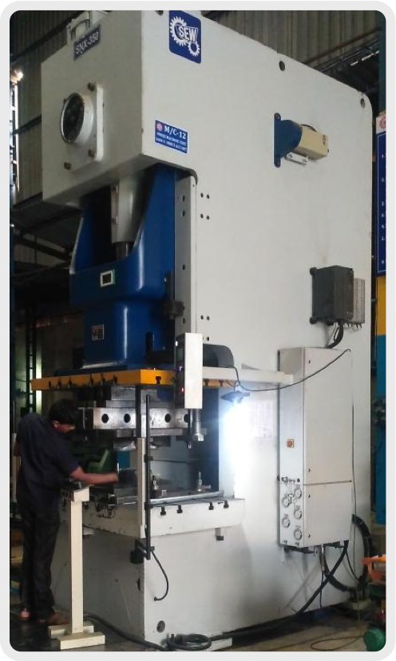
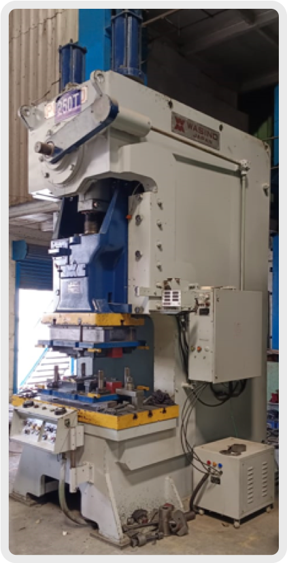
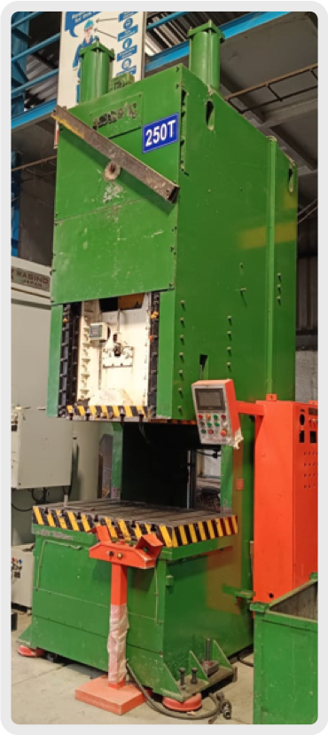
Try out facility
600 T HYDRAULIC PRESS
350 T SEW PNEUMATIC PRESS
250 T SEW PNEUMATIC PRESS
150 T MCP PNEUMATIC PRESS
Tonnage | 600 TON | 350 TON | 250 TON | 150 TON
Make | NAVEEN | SEW | SEW | MICP
Bolster size | 2500 x 1500 mm (SH-800mm) | 1500 x 800 mm (SH-625mm) | 1200 x 620 mm (SH-500 mm) | 1250 x 620 mm (SH-500 mm)
Type | H frame, double crank hydraulic press. | C frame, single crank pneumatic press. | C frame, single crank pneumatic press. | C frame, single crank pneumatic press.

Slide 7
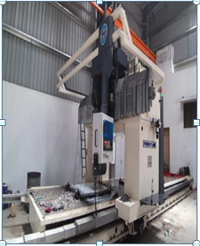
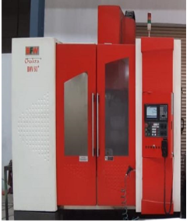
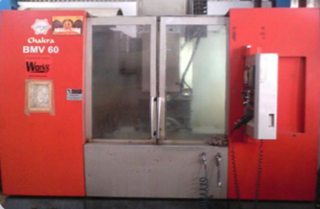
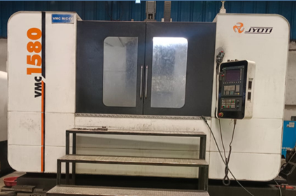
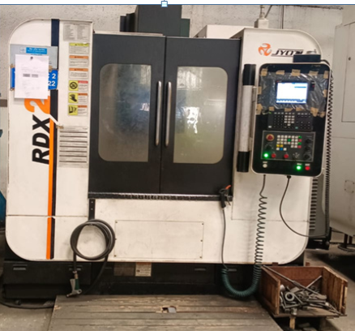
CNC milling Machines
FORESTLINE 5 AXIS
BFW - 2 no's
BFW
JYOTI
JYOTI
Model | FORESTLINE 5 AXIS | CHAKRA + BFW | CHAKRA BFW | JYOTI –VMC 1580 | JYOTI – RDX 200
Bed Size | 8500 X 2450 mm | 1200 X 650 mm | 1200 X 650 mm | 1800 X 800 mm | 1200 X 600 mm
Travel | 8000 X 2400 X 1000 mm | 1050 x 610 x 600 mm | 1050 x 610 x 600 mm | 1600 x 750 x 800 mm | 1050 X 500 X 500 mm
Max Load | 8000 kg | 1200 kg | 1200 kg | 1500 kg | 1000 kg
Controller | Siemens | Mitsubishi M70 | Mitsubishi M70 | Fanuc | Mitsubishi M80

Slide 8
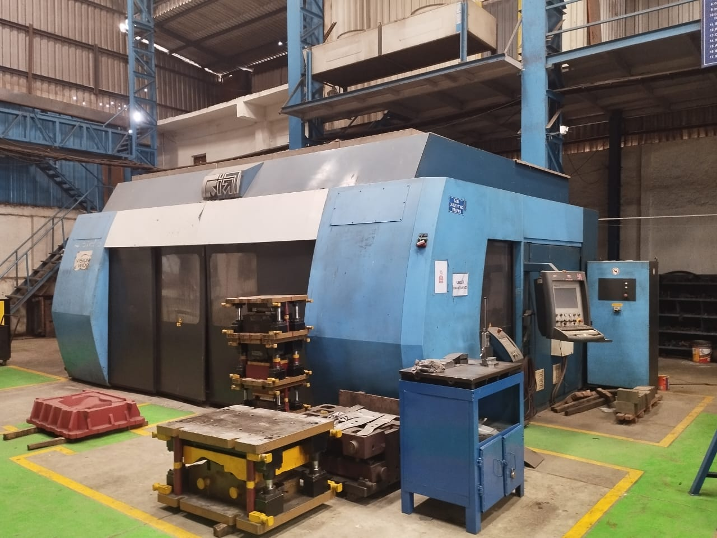
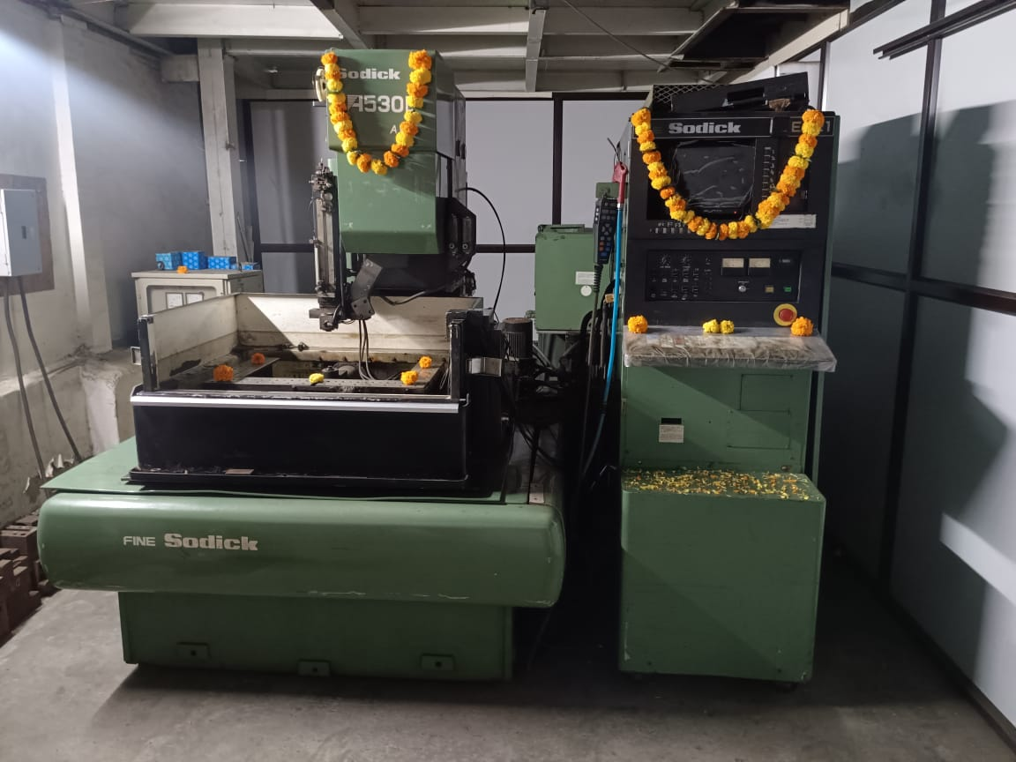
Laser cutting M/C
Wire cut M/C
Model | PRIMA P20
Bed Size | 4000 X 1500 mm
Travel | 4000 X 1500 X 75O mm
Model | SODICK A 530D
Bed Size | 900 X 600 mm
Travel | 500 X 300 X 25O mm
Resolution | 10 Micron

Slide 9
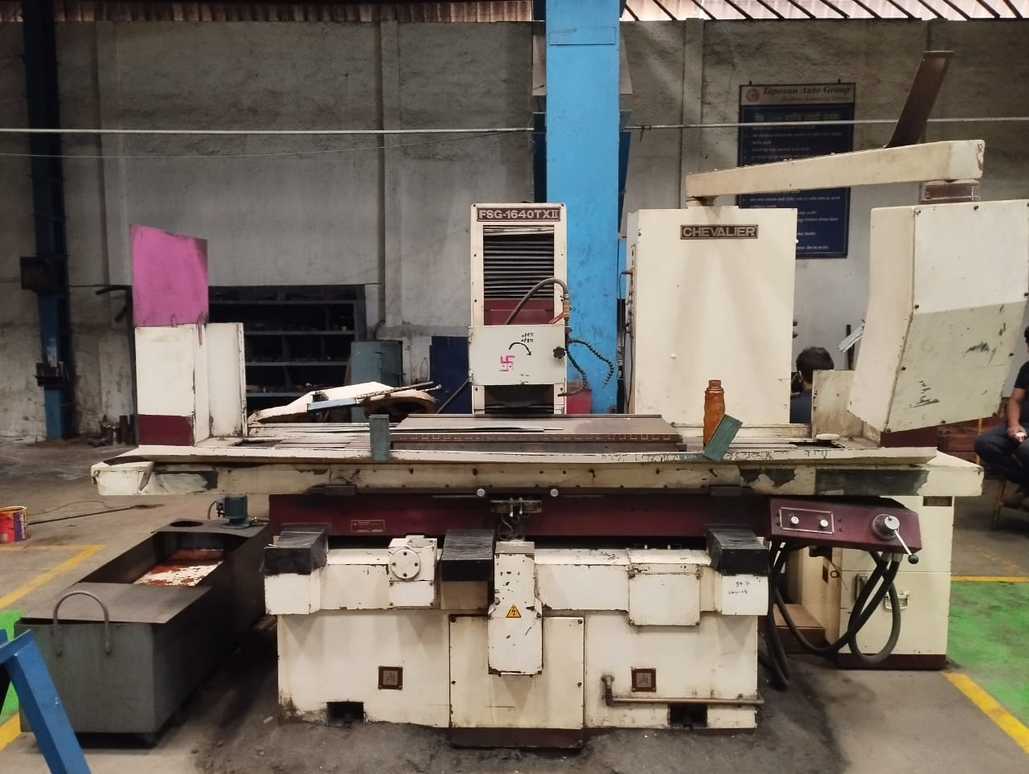
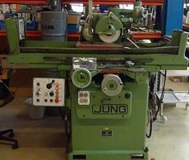
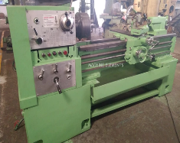
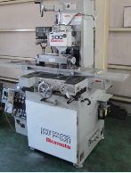
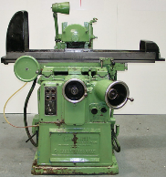
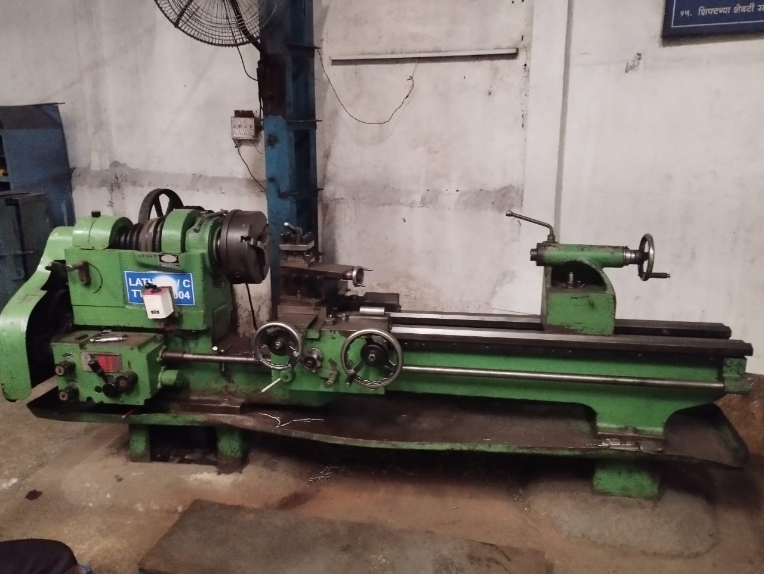
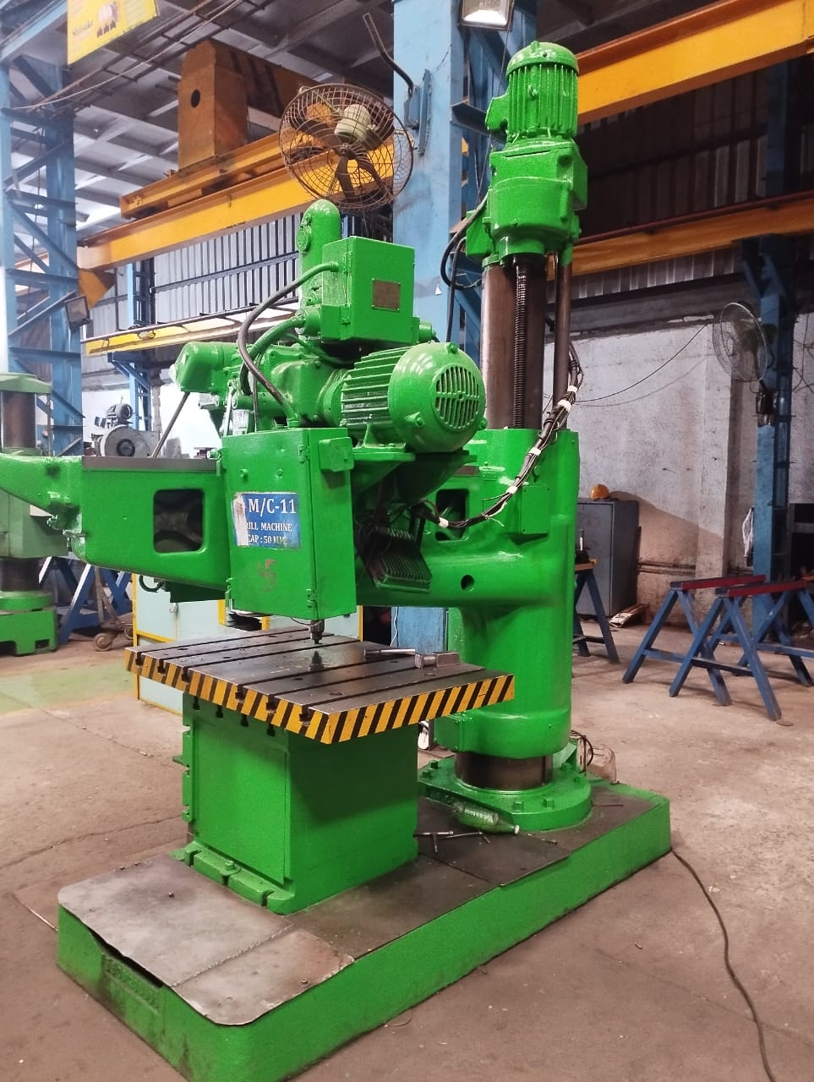
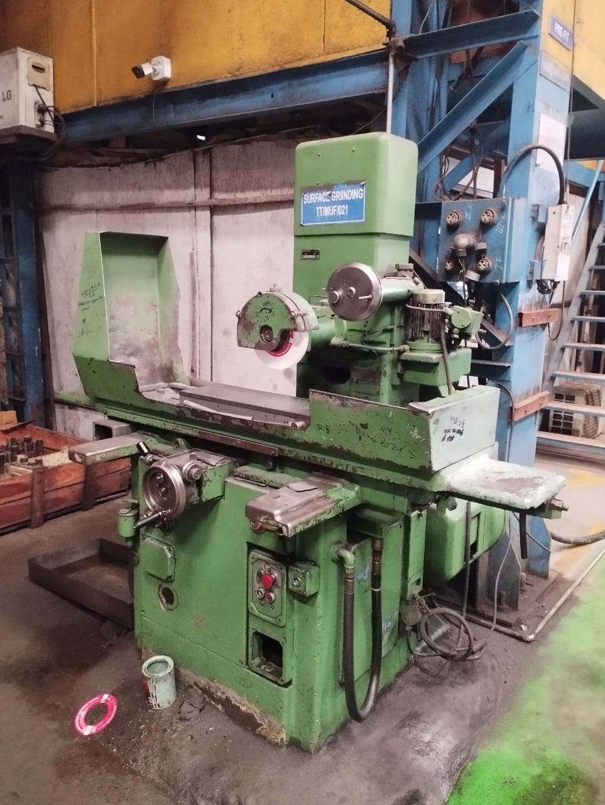
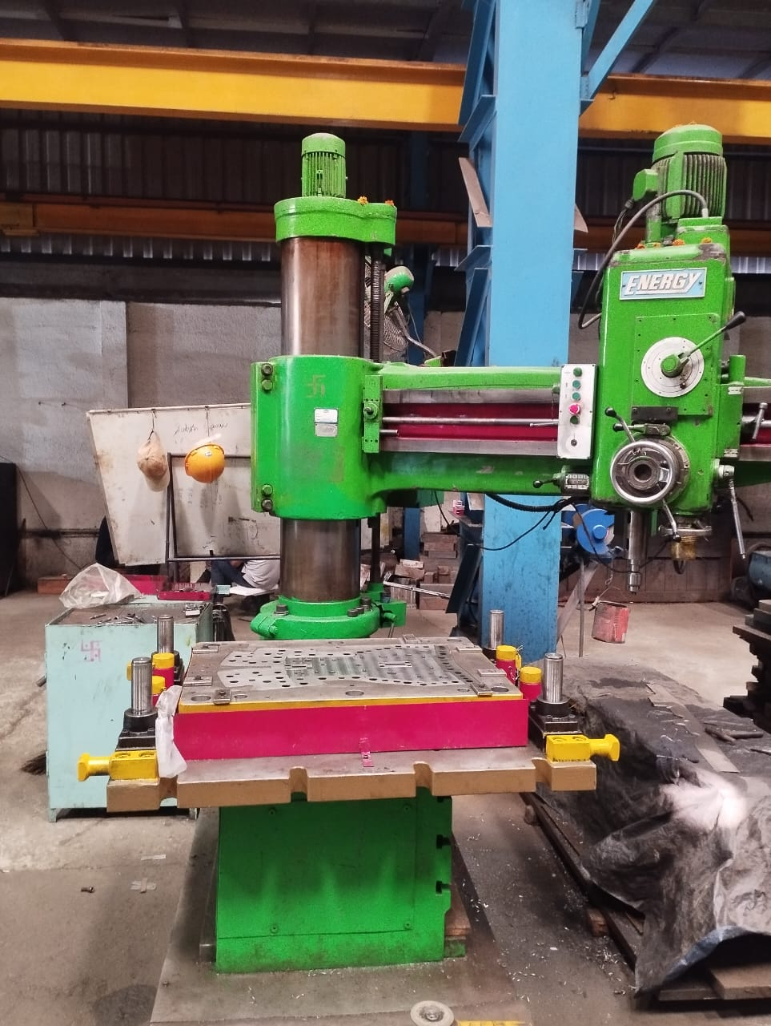
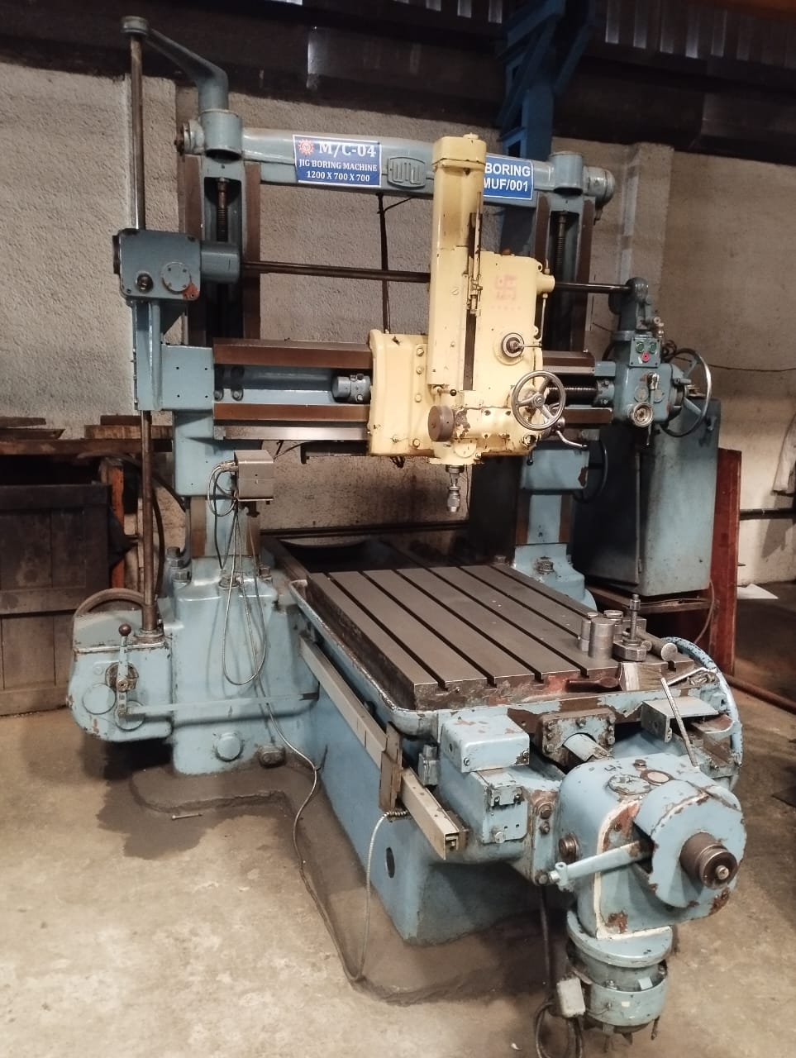
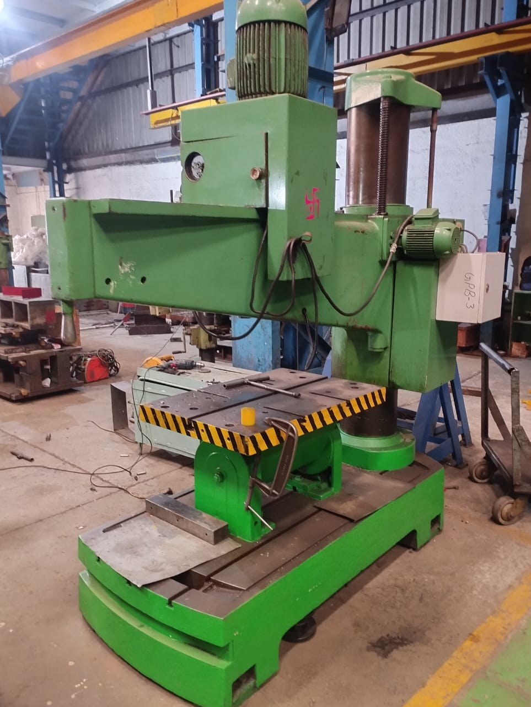
Conventional Machines
Jig Boring M/c – 1 No's
Milling machine – 2 No's
Surface Grinding M/c – 2No`s
Lathe Machine – 1 No's
Radial Drilling M/c – 3 No's

Slide 10
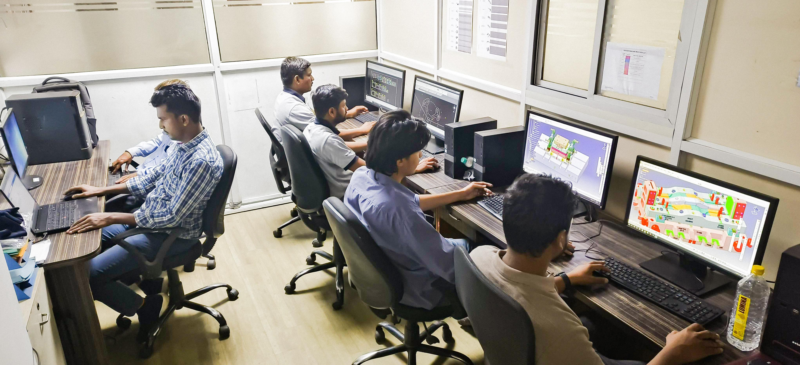
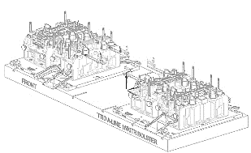
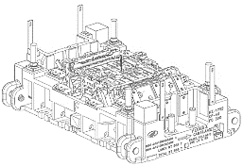

Tool Design Dept.
Design Team:-
Design Head - 2
Tool Designers - 4
Draftsman - 2
Design Software:
UG NX 11.0 : 2 seats
CATIA V5 R27 : 5 seats
Simulation Software
AutoForm – 1 seat
*All product names, logos, and brands are property of their respective owners.*

Slide 11
Tooling Division
Tooling Division :
TD delivers end to end solution for automotive sheet metal parts includes Inner & outer panels, reinforcements, frame parts from 0.2mm to 12mm with specialization in critical Parts. And also ensure first-time quality in Tandem & progressive tools
No of Tool makers :- 12
Over Head Crane :- 15 Ton (1 - no's)
5 Ton (2 no's)
Project Planning & Control
Design team-1
Design team-2
Group Leader
Group Leader
Group Leader
Group Leader
Tool Makers
Tool Makers
Tool Makers
Tool Makers
Fitters
Fitters
Fitters
Fitters
Helpers
Helpers
Helpers
Helpers

Slide 12
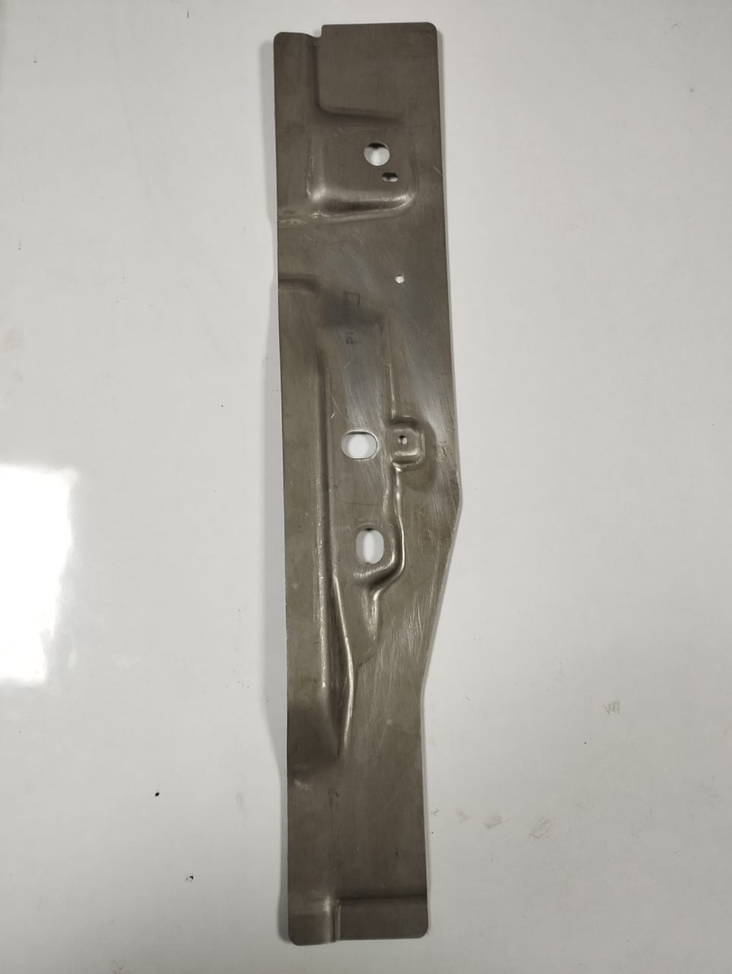
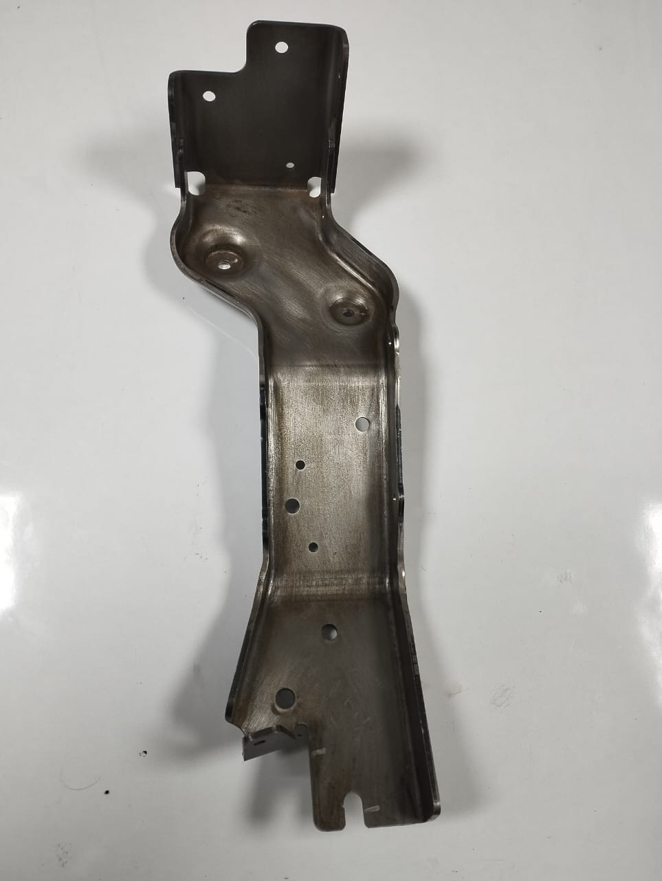
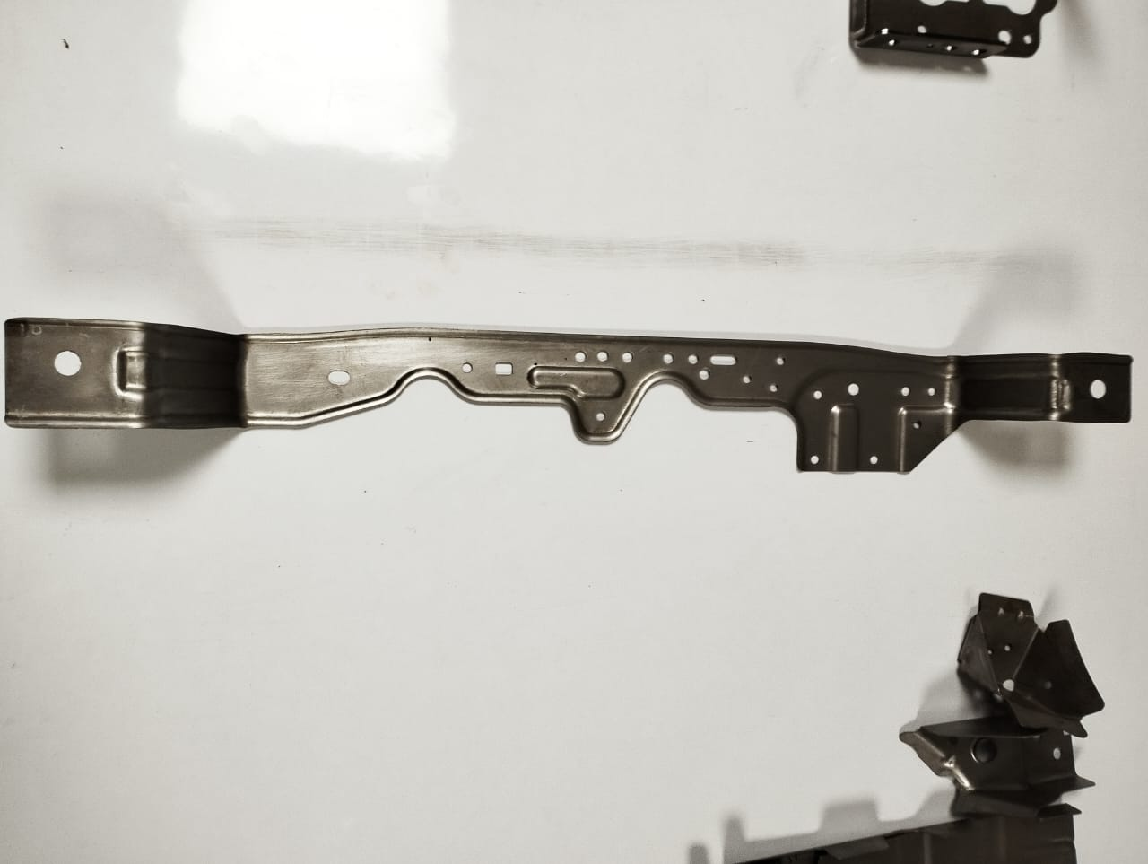
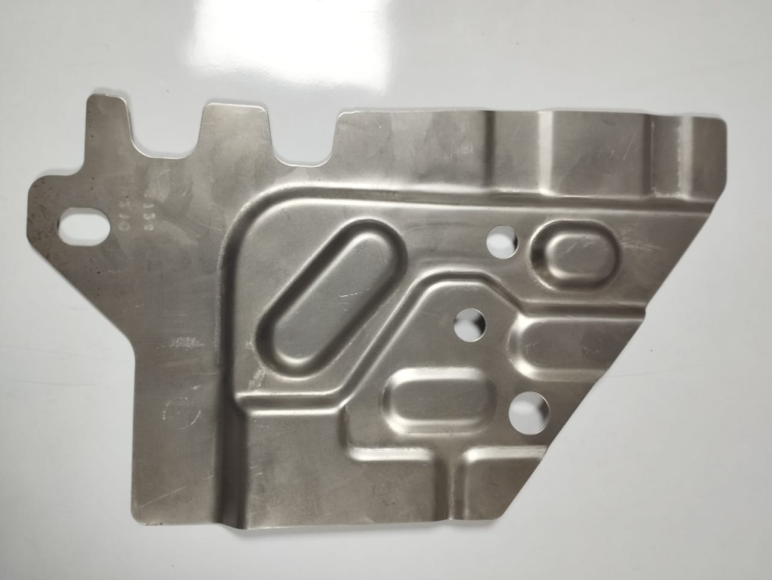
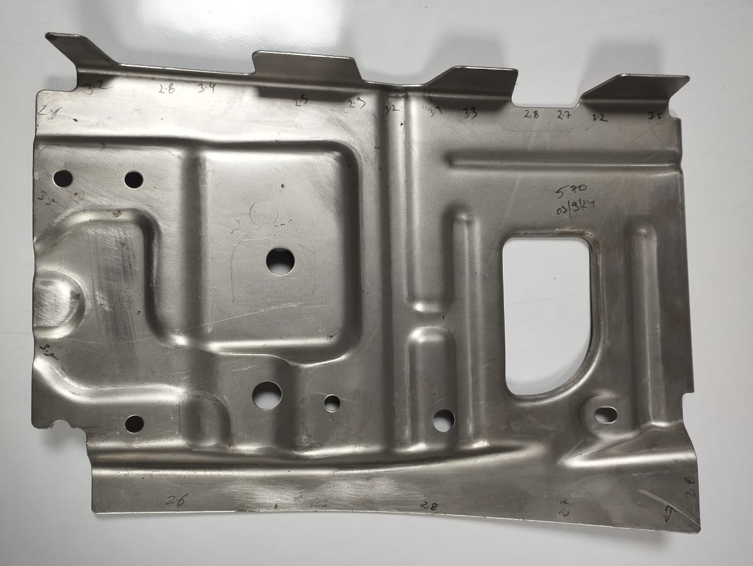
Tandem Tool Part`s
Name: Rear side wall outer RH
Material: E34
Thickness: 2.2mm
Part Size : 648x125x33mm
Tonnage :190T
Tool Development :- 12 Weeks
Customer :- Magna
Name: Bkt mid SCV support
Material: JDM AI3C
Thickness: 4mm
Part Size : 443x235x160mm
Tonnage :500T
Tool Development :- 12 Weeks
Customer :- SKH
Name: Panel assy tray mounting
Material: DP590
Thickness: 1.6mm
Part Size : 786 x100 x 65mm
Tonnage :500T
Tool Development :-12 Weeks
Customer :- M&M (TATPL)
Name: Reinforcement rear seat mtg RH
Material: HSLA340
Thickness: 1mm
Part Size : 340x200x15mm
Tonnage :55 T
Tool Development :- 4 Weeks
Customer :- Magna
Name: : Reinforcement seat belt UPR LH
Material: HSLA340
Thickness: 1.5 mm
Part Size : 355x232x33mm
Tonnage :600T
Tool Development :- 12 Weeks
Customer :- MASL

Slide 13
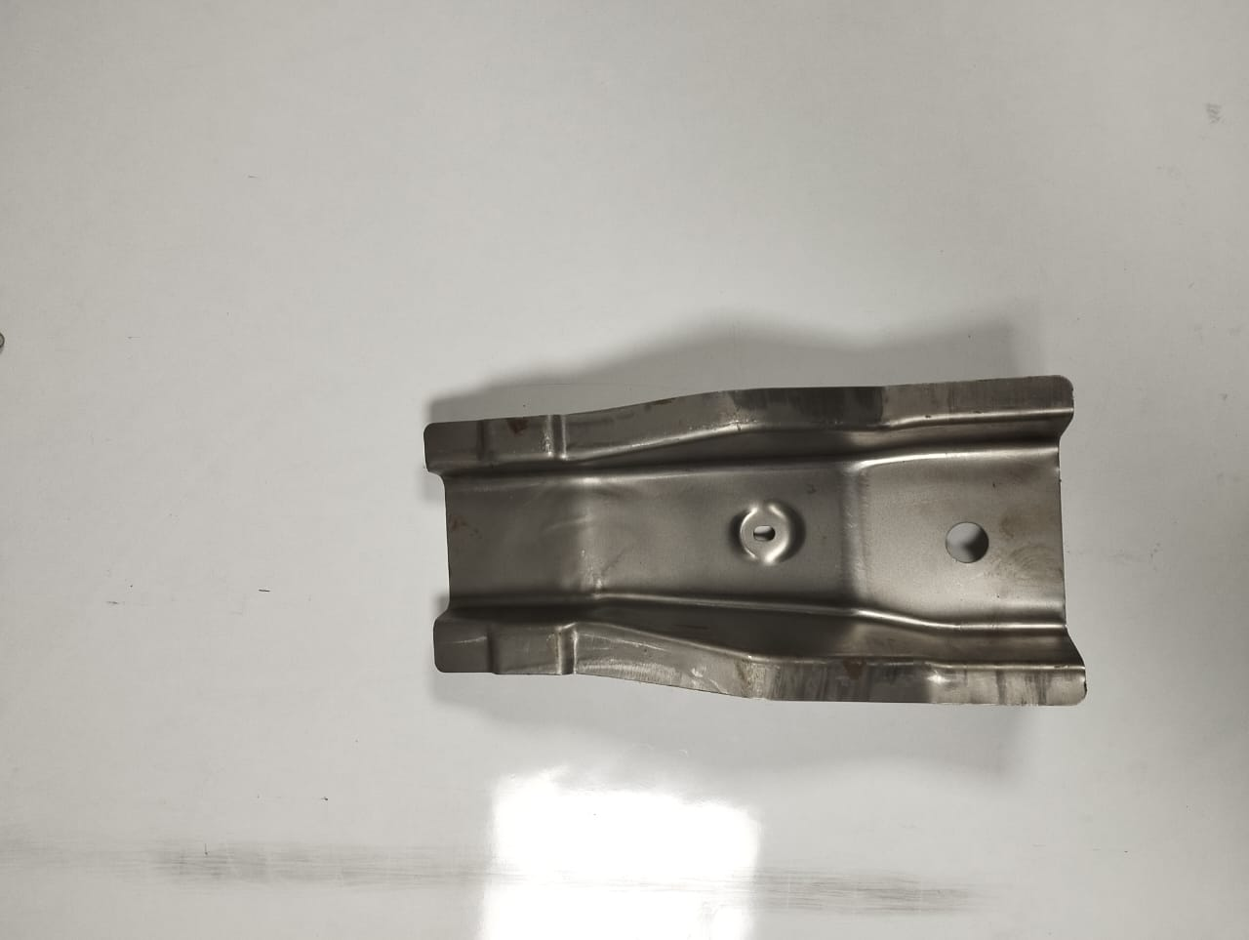
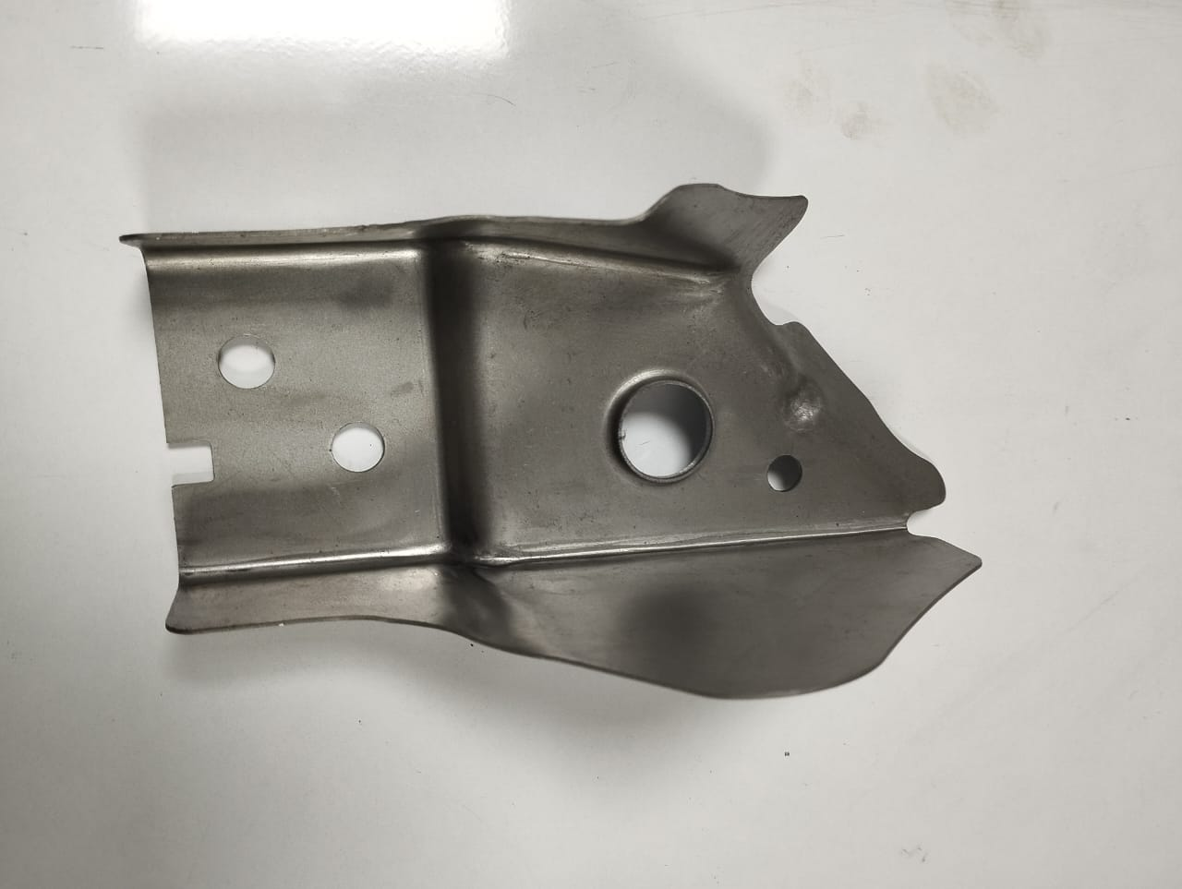
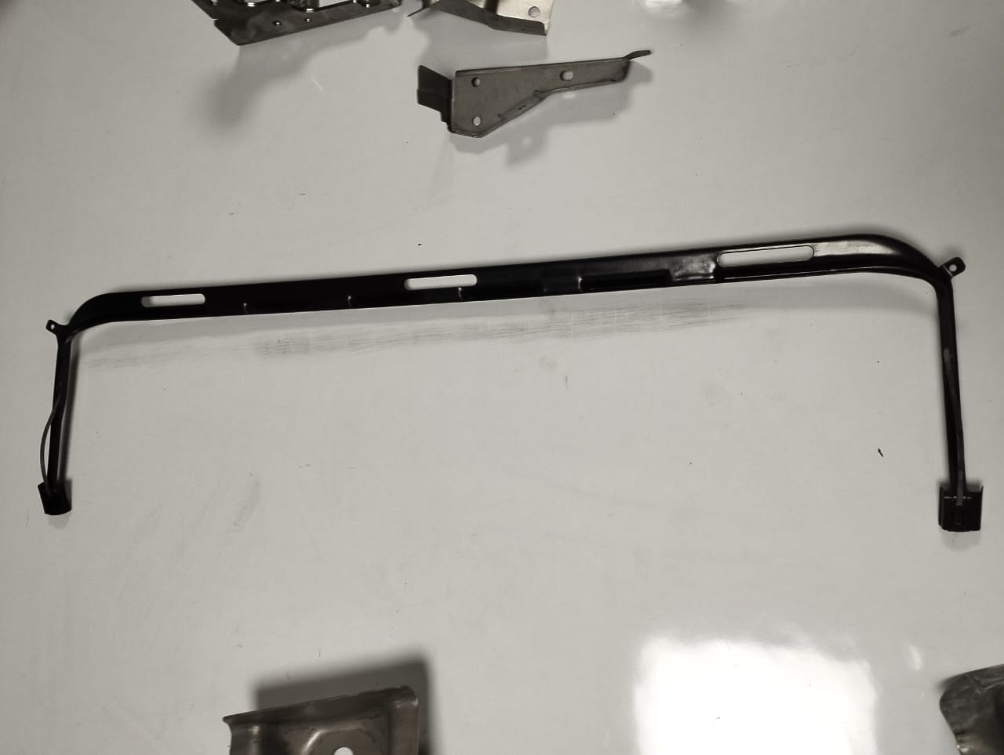
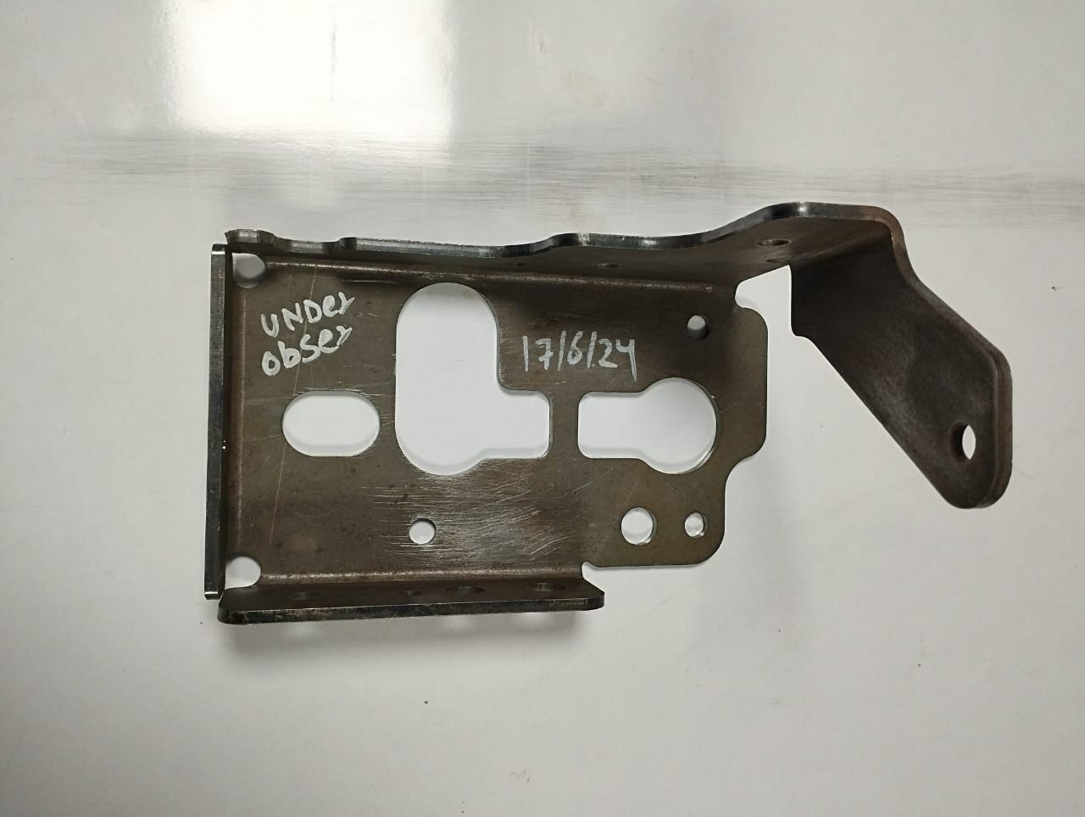
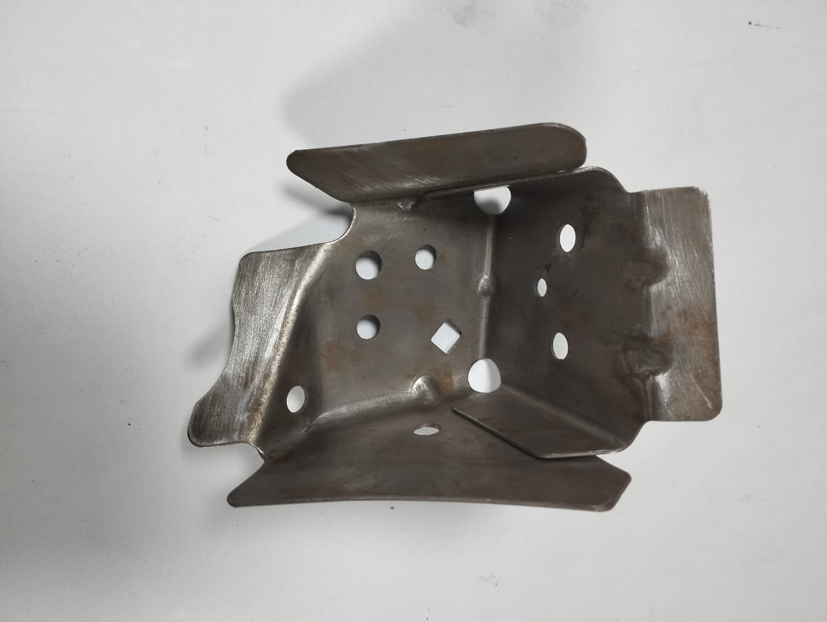
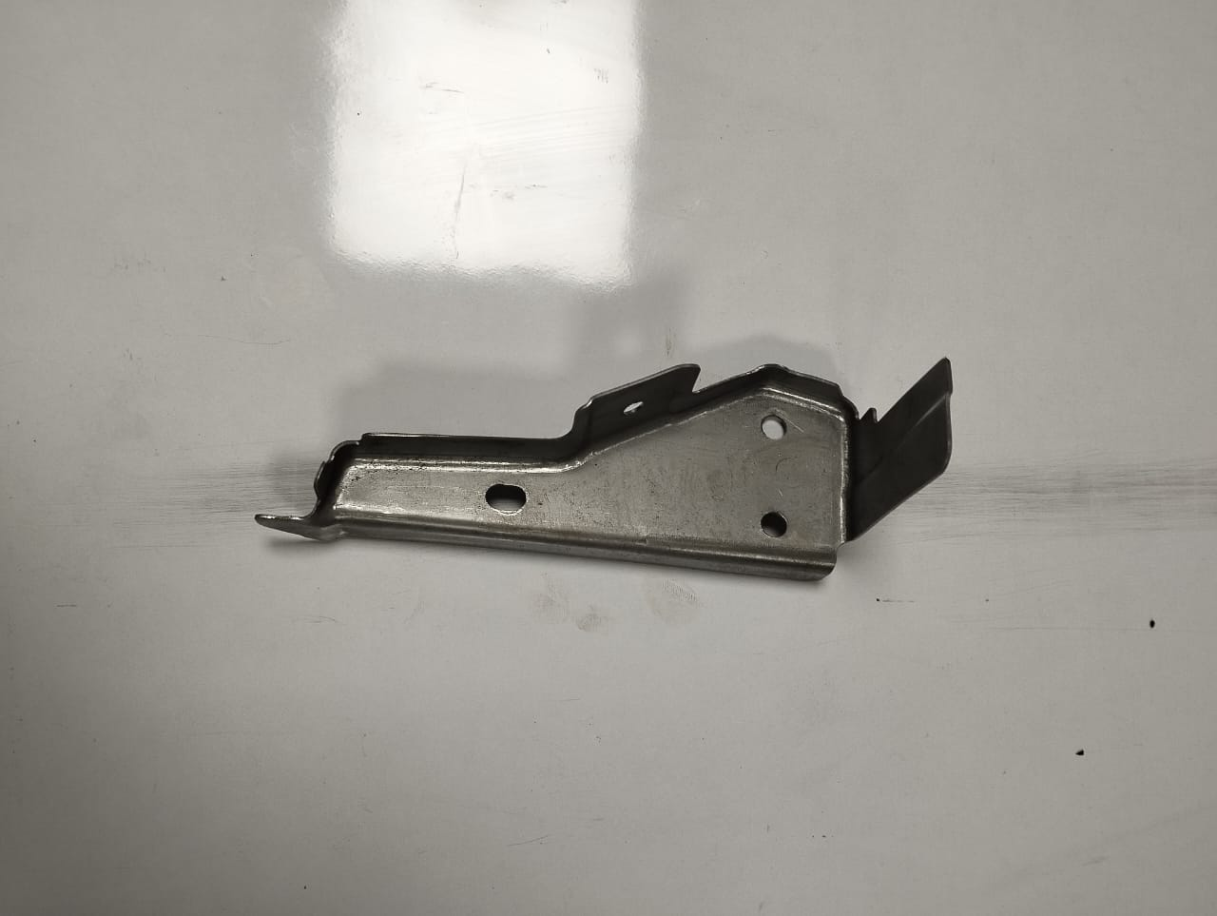
Tandem Tool Part`s
Tandem Tool Part`s
Name: Wind deflector
Material: DX53D+Z200
Thickness: 1mm
Part Size : 820x200x41mm
Tonnage :250T
Tool Development :- 12 Weeks
Customer :- CIE Golde
Name: Panel rear crmbr end cap
Material: HSLA 340GA
Thickness: 1.2mm
Part Size : 334x168x88mm
Tonnage :160 T
Tool Development :- 8 Weeks
Customer :- Magna
Name: Bkt frunk mount RH
Material: HSLA340
Thickness: 1mm
Part Size : 165X76x74mm
Tonnage :250T
Tool Development :- 8 Weeks
Customer :- MASL
Name: Bkt cap runk mount LH
Material: HSLA340
Thickness: 1mm
Part Size : 107x91x77mm
Tonnage :160T
Tool Development :- 8 Weeks
Customer :- MASL (M&M)
Name: Bkt witer frt inner RH
Material: HSLA 340GA
Thickness: 1.2mm
Part Size : 184x90x65mm
Tonnage :47T
Tool Development :- 6 Weeks
Customer :- MASL (M&M)
Name: Support mid suv
Material: JDM AI3C
Thickness: 4mm
Part Size : 199x118x148mm
Tonnage :350T
Tool Development :- 12 Weeks
Customer :- SKH

Slide 14
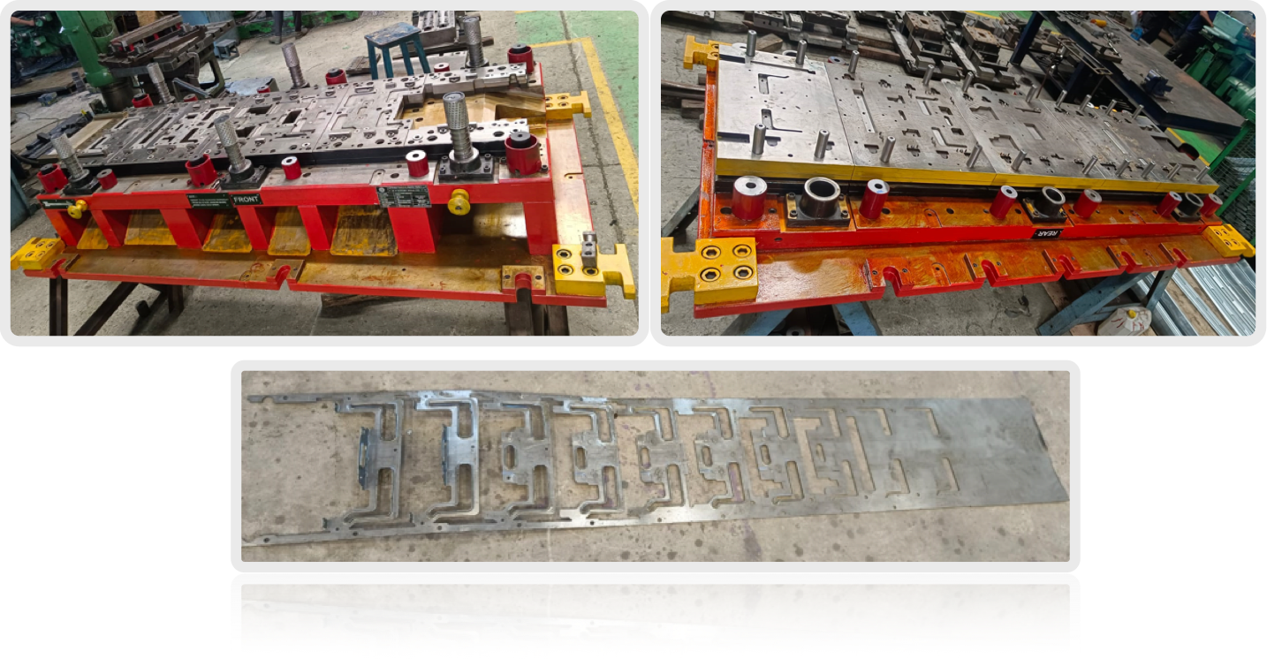
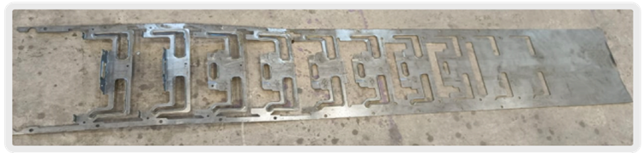
Progressive dies
11 Stage Progressive Tool
Name: Avas front holter
Material:: CR4
Thickness: 2 mm
SPM - 30
Tonnage:600T
Tool Size: :- 2200X1100X560mm
Tool Development :- 12 Weeks
Customer :- SKH

Slide 15
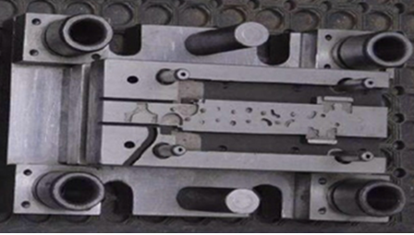
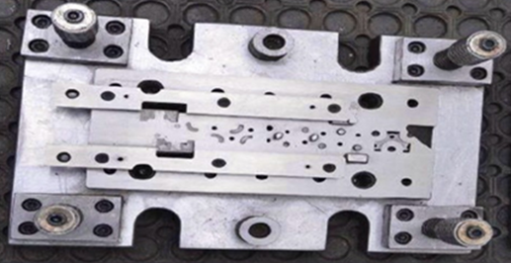

Progressive dies
7 Stage Progressive Tool
Name: DEAD LOCK STOPPER
Material:: S355MC
Thickness: 1 mm
SPM :- 45
Tonnage: 350T
Tool Size: :- 950X500X450mm
Tool Development :- 6 Weeks
Customer :- Adient

Slide 16
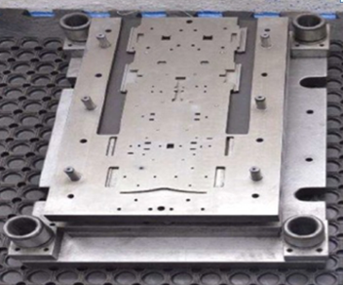
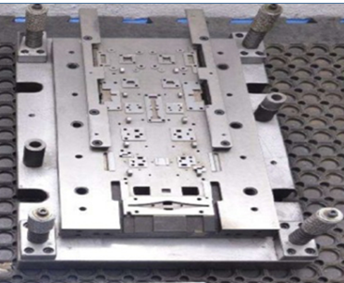

Progressive dies
8 Stage Progressive Tool
Name: Cover Plate
Material:: S355MC
Thickness: 1.2 mm
SPM :- 40
Tonnage: 250T
Tool Size: :- 850X500X450mm
Tool Development :- 6 Weeks
Customer :- Rieter India Pvt Ltd.

Slide 17

Progressive dies
16 Stage Progressive Tool
Name: Cover Plate
Material:: DC03
Thickness: 1.8 mm
SPM :- 30
Tonnage: 350T
Tool Size: :- 1250X6000X350mm
Tool Development :- 6 Weeks
Customer :- Rieter India Pvt Ltd.

Slide 18








Tandem dies

Slide 19



Tandem dies

Slide 20


Tandem dies
6 Stage Tandem die
Name: Panel assy tray mounting
Material:: DP590
Thickness: 1.6 mm
Part Size :- 786 x100 x 65mm
Tonnage: 500T
Tool Development :- 12 Weeks
Customer :- M&M (TATPL)

Slide 21



Tandem dies
4 Stage Tandem die
Name: Panel rear crmbr end cap
Material:: HSLA340
Thickness: 1.2 mm
Part Size :- 334x168x88mm
Tonnage: 160 T
Tool Development :- 8 Weeks Customer :- Magna
6 Stage Tandem die
Name: Frt side wall otr LH & RH
Material:: E34
Thickness: 2.2 mm
Part Size :- 586X196X273mm
Tonnage: 300T
Tool Development :- 12 Weeks
Customer :- Magna

Slide 22





Tandem dies
LG- 0.2mm Trim & Piercing tool for M/s Downkwang
Eicher 6mm Forming Tool for M/s Badve
Honda – Draw tool for M/s Badve.
Eicher –Forming tool for M/s Badve

Slide 23


Part Gallery

Slide 24

Part Gallery

Slide 25



Quality control Dept.
Quality Team:-
Quality Head - 1
Quality inspectors - 4
Mitutoyo Digital Height Gauge- 1 nos.
Measuring Range :600 MM.
10 micron resolution.
SIMSCAN 22 - 1 nos.
Accuracy :- u pto 0.035 mm.
Scanning rate :- up to 1250000 measurements per second.
Portable Hardness Tester - 1 nos.
Measuring Range : 17-68.5 HRC.
Future expansion plan.
Sl | Instrument | Model | Measuring range | QTY | Remarks
1 | Profile Projector | DYNASCAN PH 400E | 300mm X 150mm | 1 | With DGMS 10X & 20X magnification Lens

Slide 26






Checking Fixtures.
FIXTURES

Slide 27






Checking Fixtures.

Slide 28
Buy-Off
We supply all the Tools and Fixtures with required below given Buy-off Documents.
Design records
Method Plan
3D Design
2D Detailing
3D machining models and 2D wire cut.
Design sign-off Documents
Test Certificates
Raw Material, Heat treatment , etc.
Dimensional Inspection report
Part Lay out Inspection
Part CMM Inspection
Checking Fixture Designs
Checking fixture CMM Report
Part CF report
Dispatch documents

Slide 29



Our Clients

Slide 30
Its our pleasure to serve you.
Contact:
+91 9552266777
+91 8590019741
abhishek.mankare@tapovantools.in
vijay.mankare@tapovantools.in
premjith.john@tapovantools.in
Office address:
S Block, W220, MIDC,
Bhosari, Pune, India
Maharashtra 411026

